Slide 1




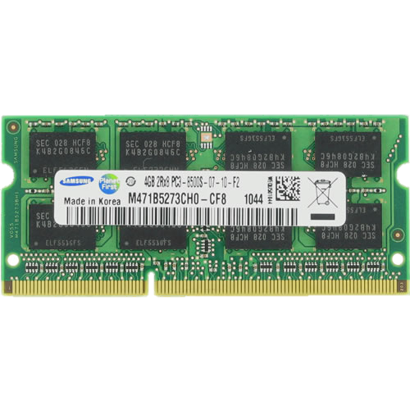
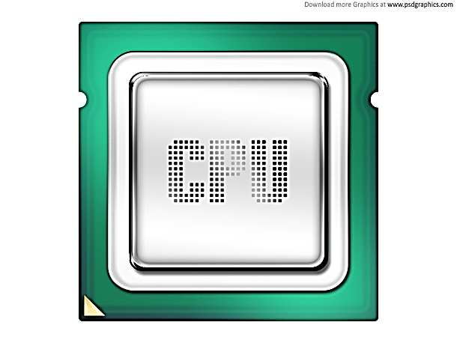
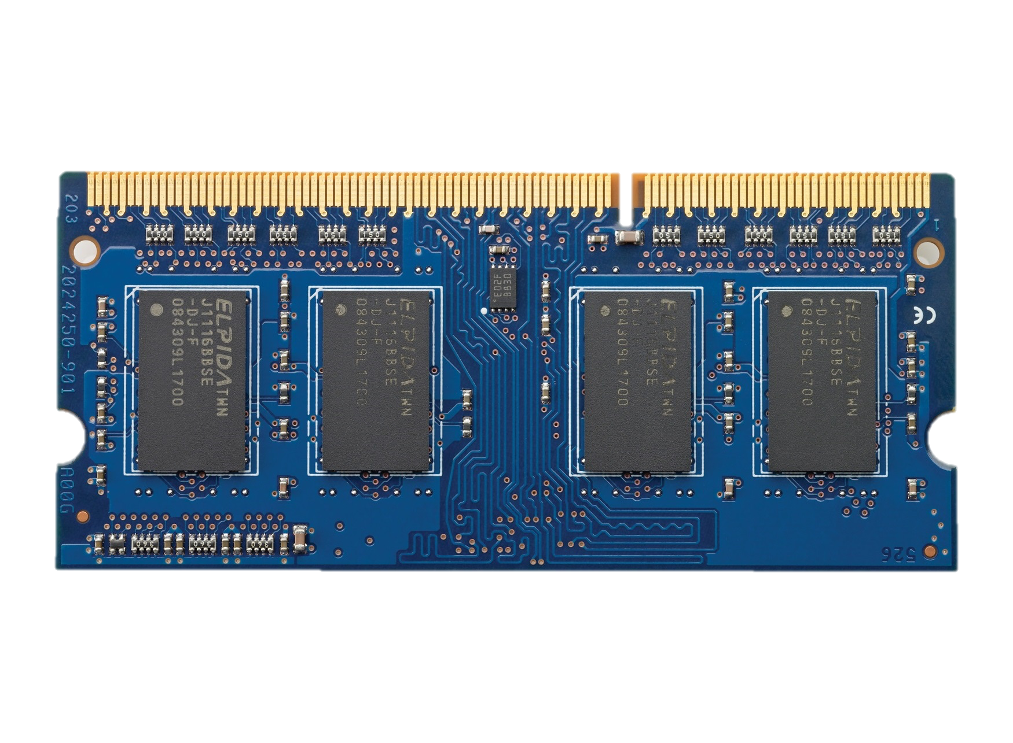

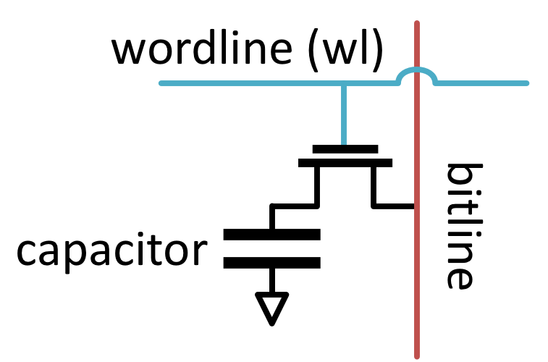


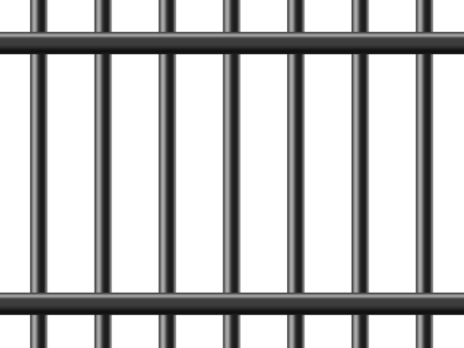







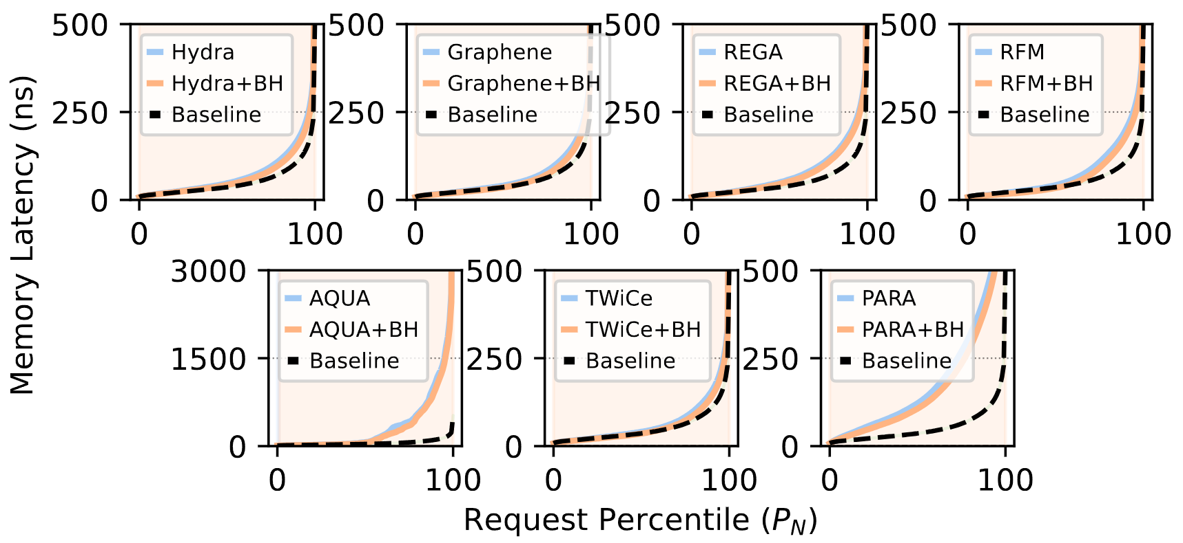
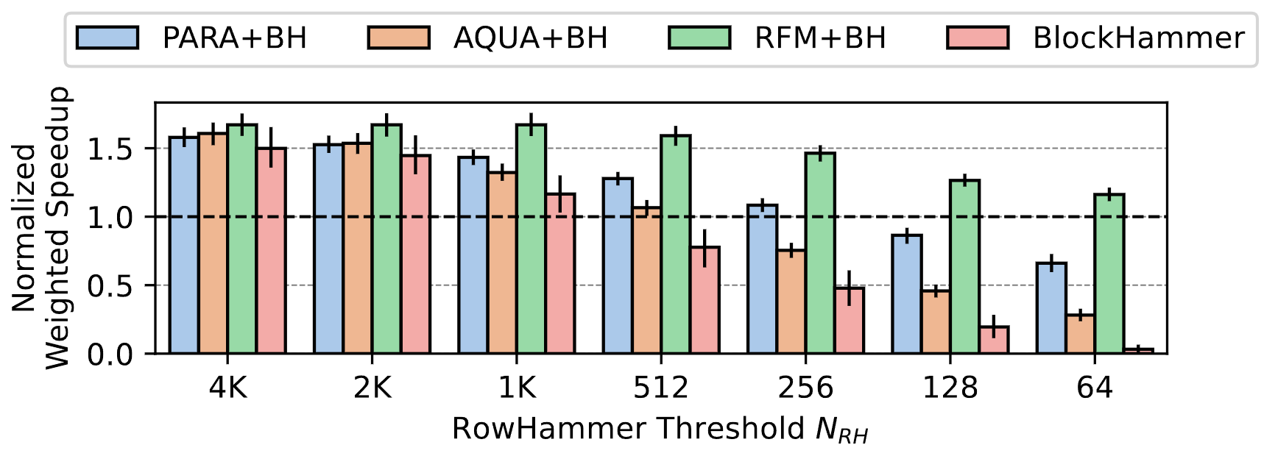
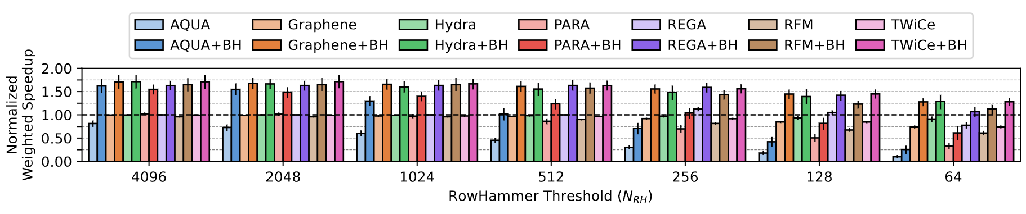
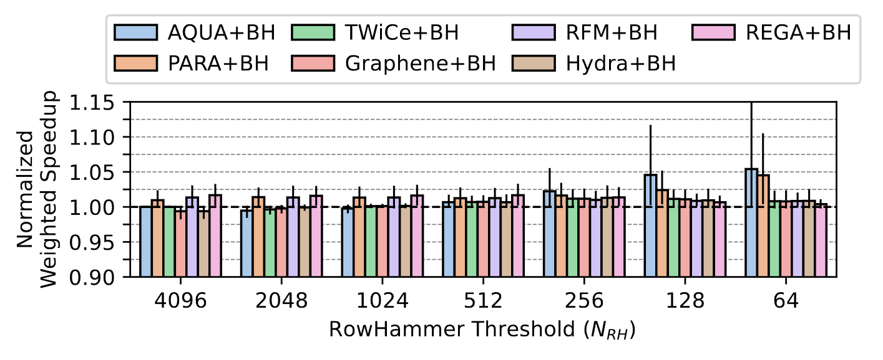
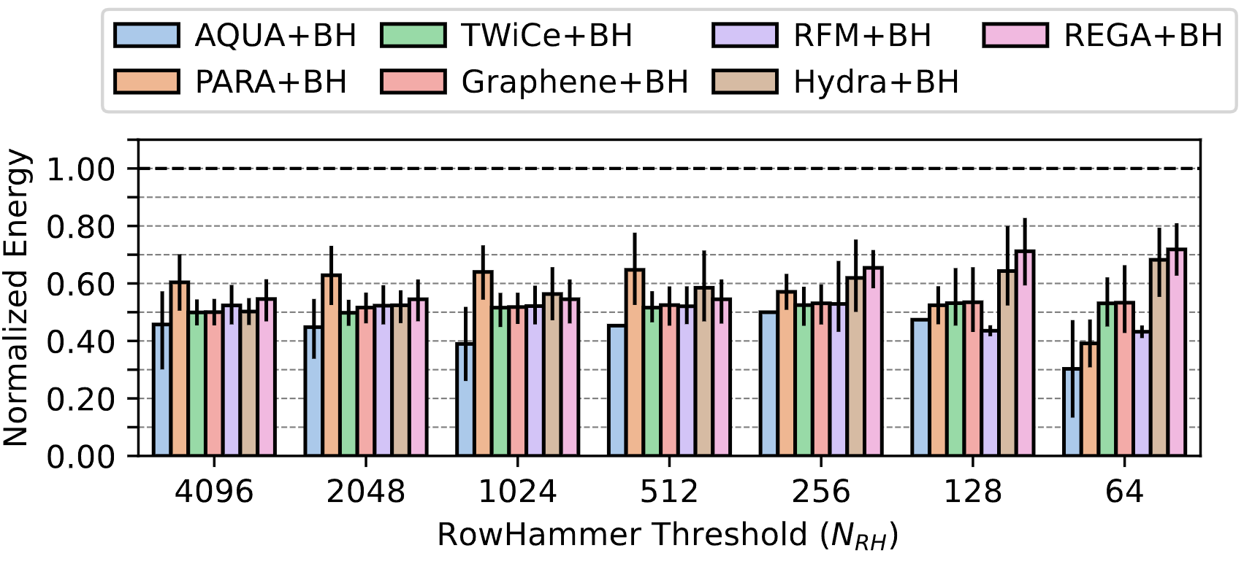
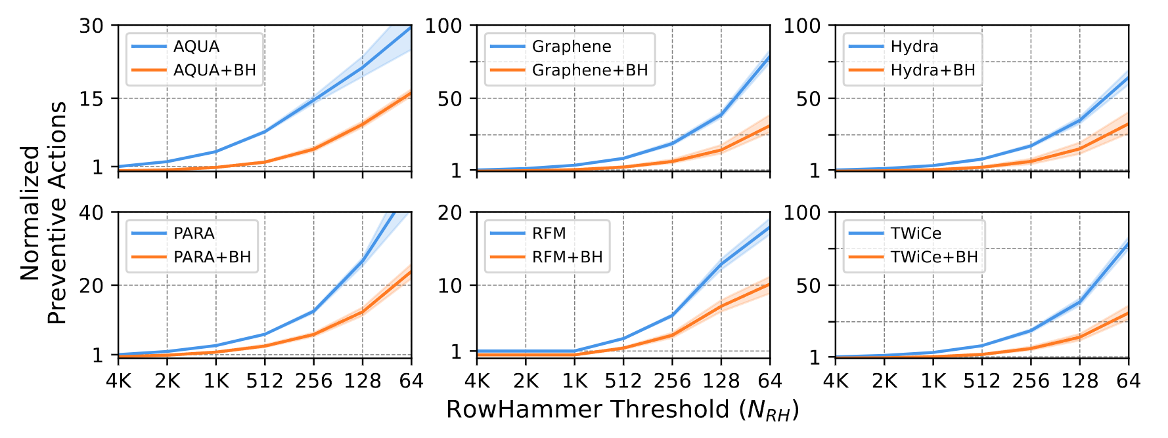
BreakHammer
Enabling Scalable and Low Overhead RowHammer Mitigations via Throttling Preventive Action Triggering Threads
Contact Info
Oğuzhan Canpolat A. Giray Yağlıkçı Ataberk Olgun İsmail Emir Yüksel Yahya Can Tuğrul Konstantinos Kanellopoulos Oğuz Ergin Onur Mutlu
Full Paper
1. DRAM Background
2. Problem and Motivation
DRAM Organization
DRAM Read Disturbance
Read Disturbance Mitigation Challenges
DRAM Subarray
RowHammer
[Kim+ ISCA’14]
Preventive refresh is a blocking operation
Row 0
Repeatedly opening and closing
OR keeping open
a DRAM row causes
bitflips in nearby cells
Row 0
Victim Row
REF
Row 1
ACT
Row 1
Row 1
Bank
bitline
DRAM Cell
wordline
Victim Row
RowPress [Luo+ ISCA’23]
DRAM
Channel
Row 2
Row 2
Row 2
Row 2
open
…
closed
Aggressor Row
DRAM Module
Chip I/O
…
Row 3
No memory access during a preventive refresh
Row 3
Row 3
…
…
…
…
Victim Row
Row 4
Row 4
Row Buffer
Victim Row
An attacker can trigger many preventive actions
to block access to main memory
Modern DRAM chips are more vulnerable
Defenses are becoming prohibitively expensive
DRAM Chip
DRAM Bank
SA₀
SA₁
…
SA_{N-1}
[Kim+, ISCA’14]
To gain insights into DRAM read disturbance and its fundamental properties
Sense Amplifiers (SAs)
[Kim+, ISCA’20]
Sense
Amplifier
[Luo+, ISCA’23]
Read disturbance mitigation is a potential attack vector
to reduce availability of the main memory
DRAM Cell
To prevent RowHammer efficiently, scalably and with no proprietary information
3. Key Idea
4. Key Mechanism: BreakHammer
BreakHammer breaks RowHammer access patterns to reduce the cost of DRAM maintenance
BreakHammer is analogous to breakwater, a structure built in coastal areas to break waves to reduce the cost of dock maintenance
Detect and slow down attackers that trigger many preventive actions
5. BreakHammer Operation
Counts the number of times a hardware thread triggers a RowHammer-preventive actions (e.g., preventive refreshes)
Slows down suspect threads by reducing the number of miss status holding registers (MSHR) they can allocate in the last level cache (LLC)
100
BreakHammer
Last
Level Cache
MSHR
Limit
BreakHammer
10
Memory
Controller
ACT
Memory
Controller
7
PREF
23
6. Performance and Energy Evaluation
Cycle-level simulations using Ramulator 2.0 [Luo+, CAL 2023] DRAMPower [Chandrasekar+, DATE 2013]
System Configuration: Processor 4 cores, 4.2GHz clock frequency, 4-wide issue, 128-entry instruction window Workloads: From SPEC CPU2006, SPEC CPU2017, TPC, MediaBench, YCSB: 1) 60 mixes all benign and 2) 60 mixes with 3 benign + 1 attack
Methodology
DRAM DDR5, 1 channel, 2 rank/channel, 8 bank groups x 4 banks x 64K rows
Memory Ctrl. 64-entry read and write requests queues, FR-FCFS scheduling with a column cap of 4 Last-Level Cache 8 MiB (4-core)
Smaller memory latency for benign workloads
7. Conclusion
Problem:
DRAM continues to become more vulnerable to RowHammer
RowHammer-preventive actions block memory accesses
Significant performance overheads
A new performance attack vector
Significantly increases (by 40%) system performance, exceeding baseline with no mitigation
Goal:
Reduce the performance overhead of mitigation mechanisms by reducing the number of preventive operations without compromising their security guarantees
Mechanism:
Slows down the threads that frequently trigger RowHammer-preventive refreshes
Key Results:
Fewer preventive actions performed across all mitigations
Significantly higher system performance
Significantly lower DRAM energy consumption
No performance/energy overhead for benign applications
Near zero hardware complexity
Significantly lower (54%) DRAM energy consumption
Significantly reduces (by 66%) the number of preventive refreshes performed

